Slide 1

Selecting A Location in Toronto For Starting An Indian Restaurant
Sanjay Ramachandran
May 1, 2020

Slide 2
Background, Problem and Audience
Background
The Indian subcontinent has many different cuisines that it is not too difficult to identify one that is not prevalent in that area and capitalize on it
Toronto is the most populous city in Canada and in 2016, 47% of its population was international
Problem
An Indian restaurant needs to be started in Toronto. There were six boroughs in Toronto out of which one needed to be identified for the location of the restaurant. The six boroughs were East York, Etobicoke, North York, Old City of Toronto, Scarborough and York. The analysis could then be drilled down to locate a neighborhood within the borough
Target Audience
The target audience for this analysis is a restaurateur or an organization that is planning on starting am Indian restaurant in Toronto

Slide 3
The Data
The demographics of Toronto neighborhoods was scraped from https://en.wikipedia.org/wiki/Demographics_of_Toronto_neighbourhoods
There were 174 neighborhoods in Toronto
Borough code, neighborhood, population and income for every neighborhood in Toronto were extracted and loaded into a dataframe
Coordinates for all the boroughs in Toronto were compiled and stored in a dataframe
Foursquare API was used to extract the Indian restaurants in all the Toronto boroughs

Slide 4
Methodology
Population, income and number of currently existing Indian restaurants in each borough were assumed to be the 3 factors that would influence location of the new Indian restaurant
Population and income were considered to be positive factors in the model
Number of currently existing Indian restaurants was considered to be a negative factor in the model since demand can be reduced when there are restaurants already existing in the area
Foursquare API was used to query for Indian restaurants within a distance of 1000 meters from the center of each of the 6 boroughs

Slide 5
Methodology
The 3 factors were scaled to have values between 0 and 1
All factors were considered to have the same weight
Boroughs with no Indian restaurants were added to the dataset with a restaurant count of zero, since there were 2 other factors that could influence the restaurant location selection
Heat maps were created to visualize the boroughs and the restaurant locations
K-means clustering was run for visualizing how close the restaurant clusters stay within the boroughs

Slide 6
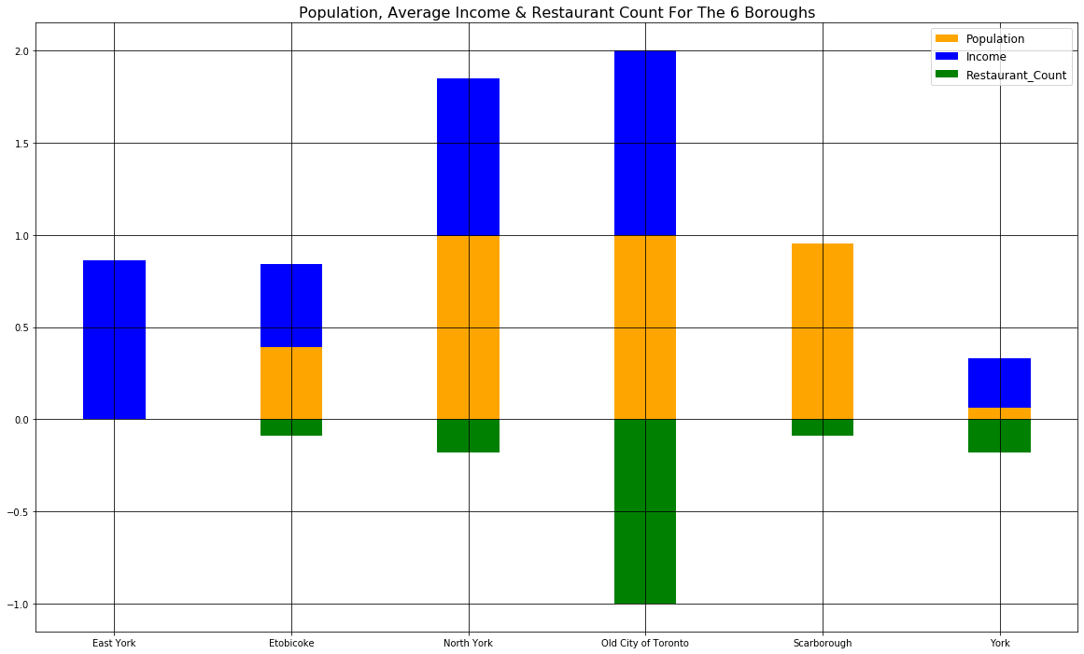
Methodology
A stacked bar graph was drawn to display the effect of the 3 factors

Slide 7
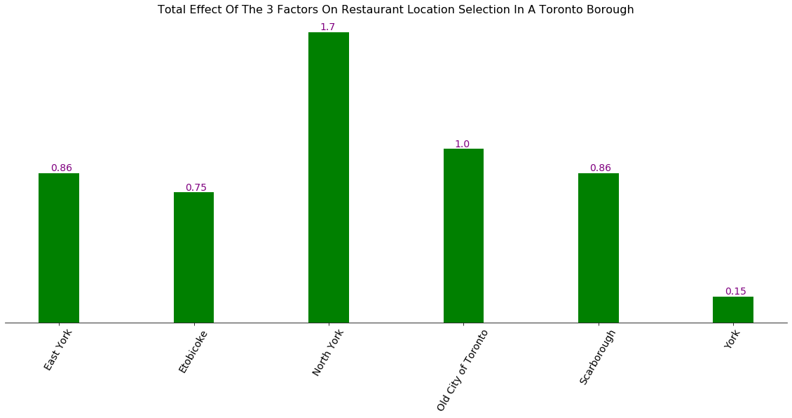
Methodology
The algebraic sum of the 3 factors called the total factor was plotted on a bar graph

Slide 8
Methodology
North York with the highest total factor was drilled further to get to the neighborhoods
Since North York had only 2 Indian restaurants, K- means clustering was deemed unnecessary
The 2 restaurants were determined to be in 2 different neighborhoods that were adjacent to each other
The total factor was determined for each of the 40 neighborhoods in North York

Slide 9
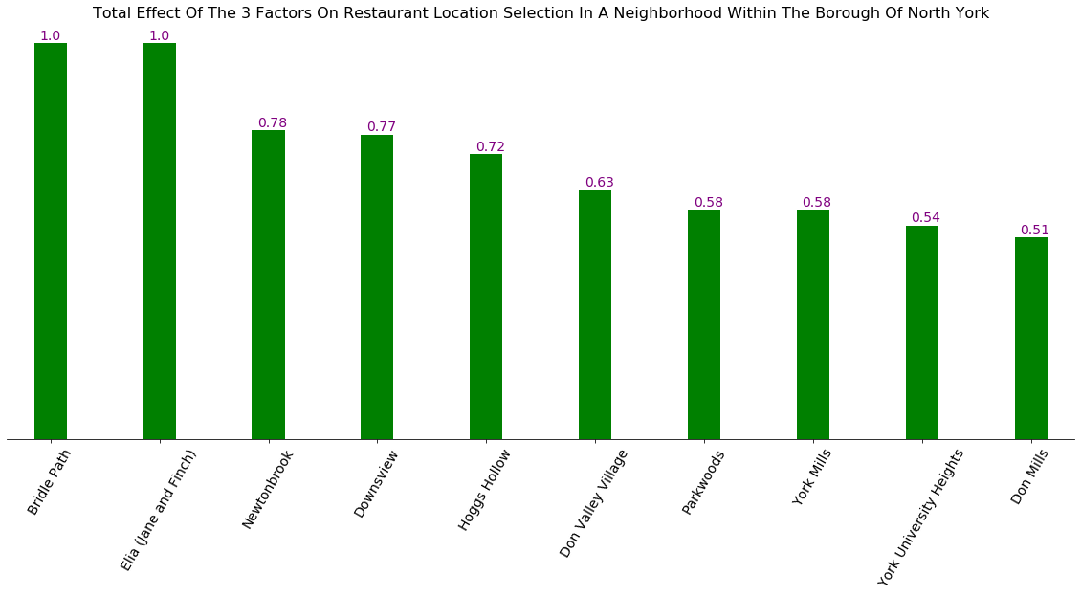
Methodology
Since only the top location was needed, for comparison, only the top 10 locations by descending order of total factor were plotted on a bar graph

Slide 10
Results
K-means clustering grouped the restaurants into clusters that were comparable to the actual borough centers
The clustering showed that the restaurants were not along the boundaries of the boroughs but around the centers
North York was the best borough to host the restaurant. The best neighborhoods within North York, to host the new Indian restaurant were found to be Bridle Path and Elia (Jane and Finch)

Slide 11
Discussion
The results can be influenced by factors not considered in the model
Factors like restaurant popularity, diversity index and land value could change the results
If there are many unpopular restaurants in the borough, it's possible that a new restaurant in that borough may still be a good idea since it may be able to beat out the competition and consume a majority of the demand
Diversity index, if available, could positively influence the location selection since an international population could be more inclined to going to international restaurants
A higher land value would increase the investment cost but that could be offset by an increase in demand for the new restaurant

Slide 12
Discussion
If inclusion of additional factors moved the best borough to one that has several Indian restaurants, K-means clustering would need to be done within the borough
In this case, the restaurant would need to stay outside any of these clusters to not compete with existing restaurants close by

